Slide 1
Municipal Separate Storm Sewer System (MS4)
General Permit Renewal (OHQ000004)
John Mathews/Jason Fyffe
Ohio EPA
Division of Surface Water

Slide 2
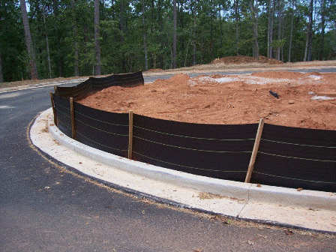
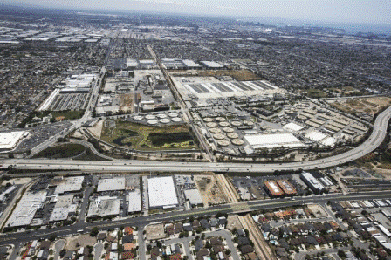
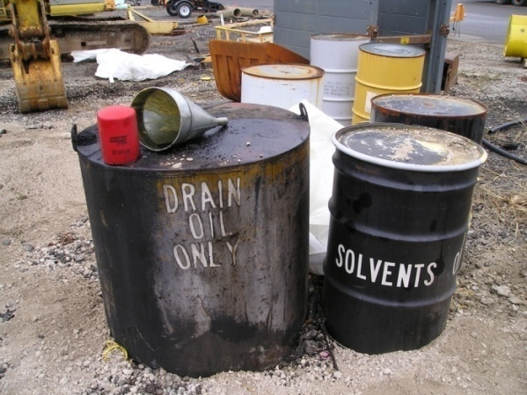
Ohio EPA Storm Water Program Areas
Construction Activities
Municipal Separate Storm Sewer Systems (MS4)
Industrial Activities

Slide 3
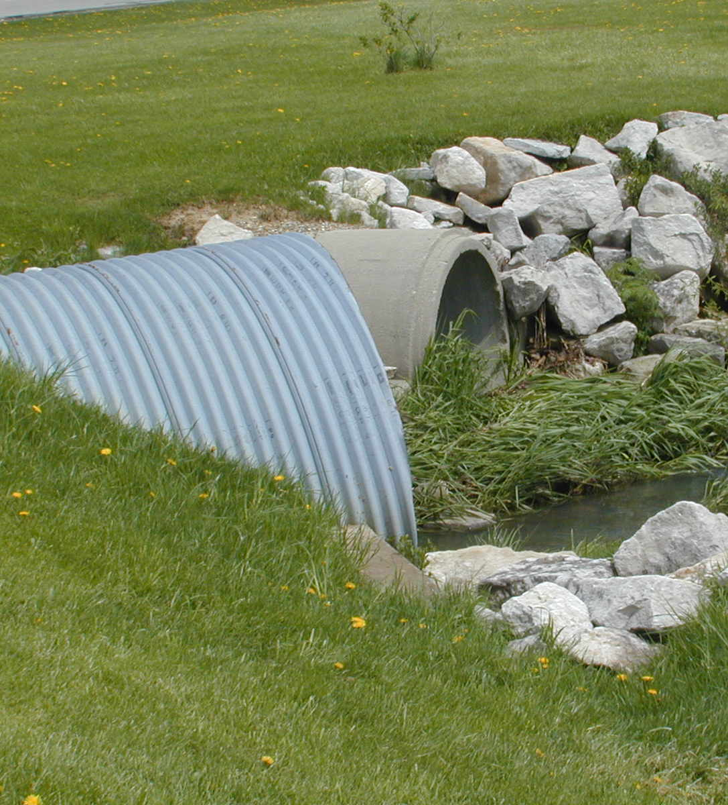
MS4 Program
Municipal Separate Storm Sewer System (MS4)
Refers to a system of conveyances-drainage systems, swales, ditches, gutters and storm sewers

Slide 4
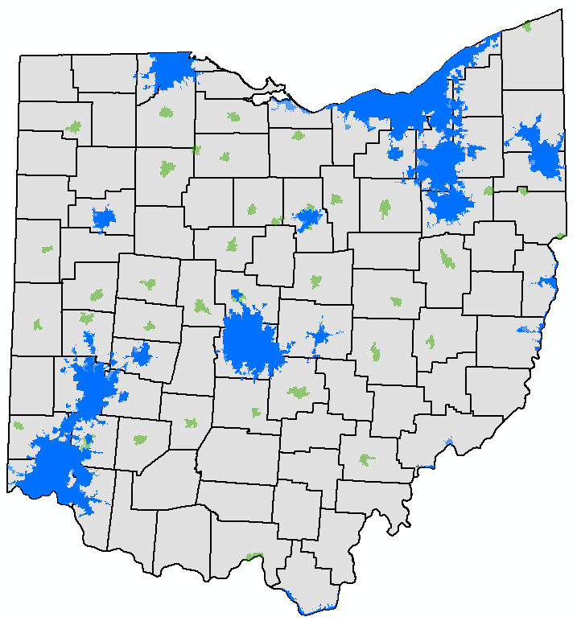
MS4 Program
Phase I MS4s
>100,000 ppl, primarily not combined sewers
Individual permits
Akron, Columbus, Dayton & Toledo
Phase II MS4s
Within an urbanized area (defined by last census) or designated by population, population density and other factors
619 Small MS4s covered under 296 general permits
Typically cities, counties, townships, but may include park districts, department of transportation, universities etc.

Slide 5
MS4 Program
Phase I MS4s
Columbus - Working to renew
Dayton - Expires 10-2022
Akron - Working to renew
Toledo - Working to renew
Phase II MS4s
Permit expires September 10, 2019
Permits are renewed every 5 years.

Slide 6
MS4 Program: What’s Required?
Submittal
  Notice of Intent (NOI)
  Storm Water Management Program (SWMP)
  Alone or Co-Permittee
Develop and Implement SWMP
  In each MCM
Recordkeeping/Reporting
  Submit reports to Ohio EPA
  Maintain other records/documentation

Slide 7
Storm Water
Management Program (SWMP)
Best Management Practices (BMPs) that address the 6 Minimum Control Measures
Legal authority
Performance standards
Timeframes for BMP implementation
Point of contact/responsible parties
How success of minimum control measures and BMPs will be evaluated

Slide 8

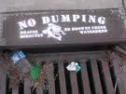
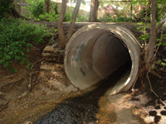
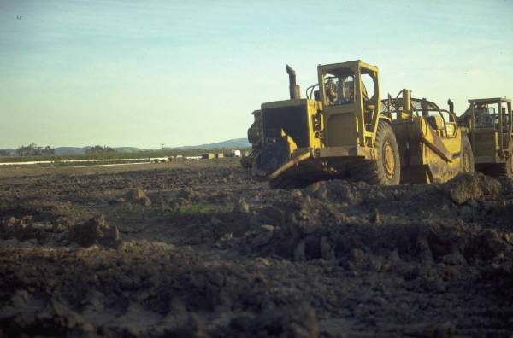
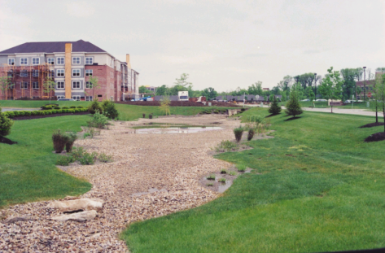
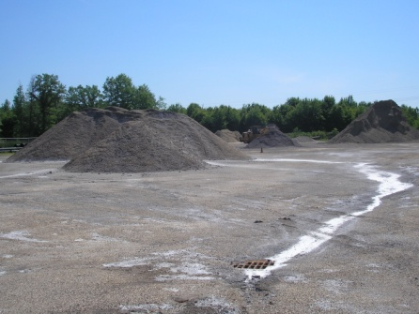
Six Minimum Control Measures
Public Education & Outreach
Public Involvement & Participation
Illicit Discharge Detection & Elimination
Construction Site Runoff Control
Post-Construction Storm Water Management
Pollution Prevention / Good Housekeeping

Slide 9
Public Education & Outreach / Public Involvement/Participation
Public Education Performance Standard:
Storm Water Public education and outreach program shall include more than one mechanism and target at least five different storm water themes over the permit term. At a minimum, one theme shall target the development community. Program must reach 50 percent of your population over the permit term.
Public Involvement/participation Performance Standard:
Public involvement / participation program shall include, at a minimum, five public involvement activities over the permit term.

Slide 10
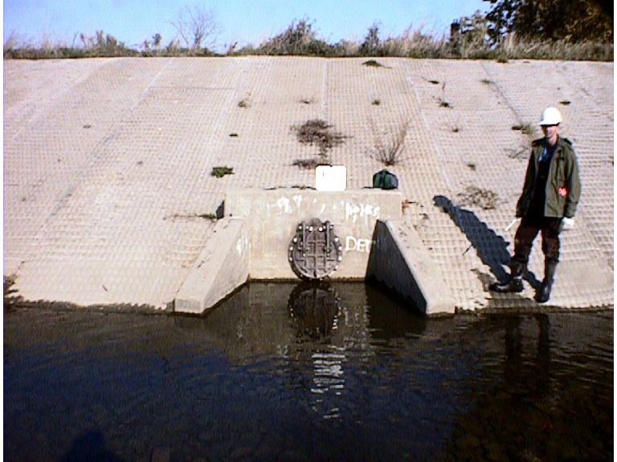
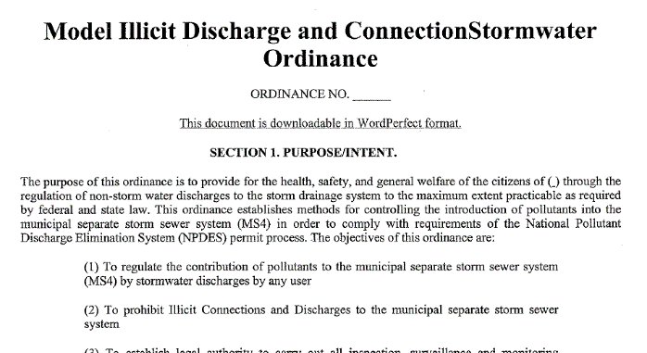
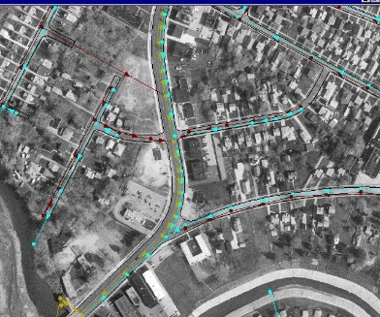
Illicit Discharge Detection & Elimination
“…any discharge to an MS4 that is not composed entirely of storm water, except for fire-fighting activities and NPDES permitted discharges.”

Slide 11
Illicit Discharge Detection & Elimination
Performance Standards:
Shall include an initial dry-weather screening of all your storm water outfalls over the permit term.
Your program shall establish priorities and specific goals for long-term system-wide surveillance of your MS4, as well as for specific investigations of outfalls and their tributary area where previous surveillance demonstrates a high likelihood of illicit discharges.
Data collected each year shall be evaluated and priorities and goals shall be revised annually based on this evaluation.
Comprehensive storm sewer system map (updated annually).

Slide 12
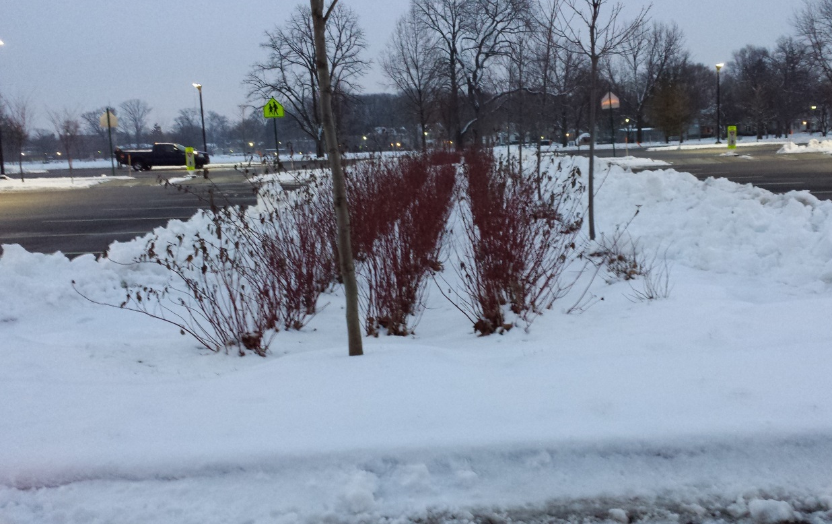
Construction Site Runoff Control
Post-Construction Runoff Control

Slide 13
Construction Site & Post-Construction Runoff Control
Performance Standards:
Storm Water Pollution Prevention Plan (SWP3) review of all applicable projects
Inspect applicable sites initially then on at least a monthly basis
Ensure that controls are installed per requirements
Ensure that long-term Operation & Maintenance Plans are developed and agreements in place
Common issues
  Inconsistent ordinances, resolutions, regulations
  Lack of formal plan review and inspection process
  Lack of Enforcement Protocol

Slide 14
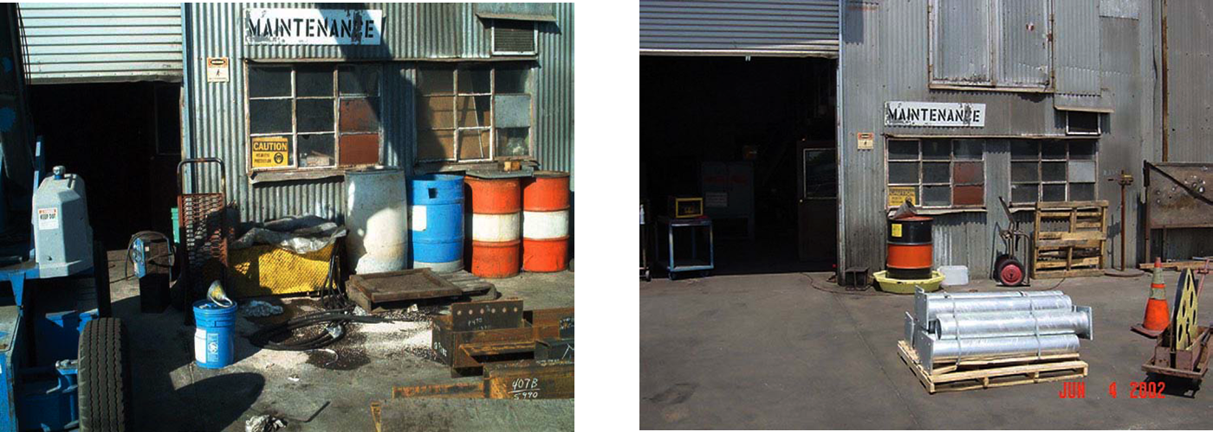
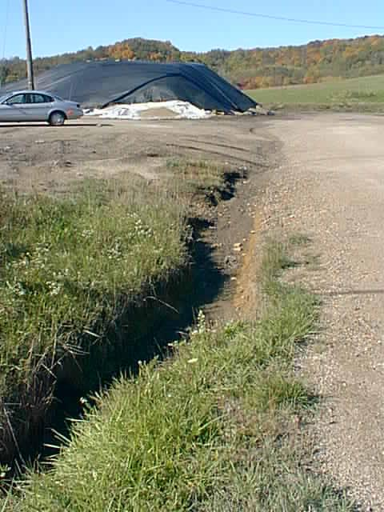
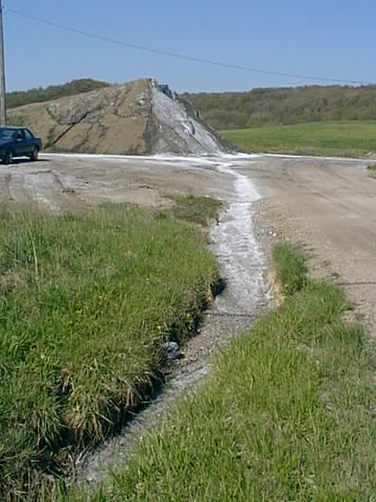
Pollution Prevention/Good Housekeeping for Municipal Operations
Operation and Maintenance Program
Maintenance activities, schedules and long-term inspection procedures
BMPs for streets, parking, maintenance areas, transfer stations, salt/sand storage locations and snow disposal areas
Procedures for proper disposal of waste
Conduct employee training once per year (min)

Slide 15
MS4 Permit Renewal Timeline
Month | Action Item
Jan/Feb 2019 | Early Stakeholder Outreach meetings to promote interested party input for GP renewal
March 2019 | Review input and develop a draft GP with proposed changes
April 2019 | Public Notice Draft GP for public comment
 | Comment Period ends 52 days after Public Notice
June/July 2019 | Review/evaluate comments received and develop final GP

Slide 16
How to provide input:
Input is invited. Descriptive suggested changes or examples of issues are most helpful.
Send email by March 6, 2019:
Jason Fyffe
Ohio EPA, Division of Surface Water
Jason.Fyffe@epa.ohio.gov

Slide 17
Potential Updates or Changes
Require update of ordinances and regulations within X months of renewal of MS4 General Permit (reduce from 24 months)
Adjust language regarding plan review and inspection to ensure thorough process and documentation
Require enforcement protocol (e.g. notices of violation in an enforcement escalation plan)

Slide 18
Potential Updates or Changes
Address how MS4s show in their Storm Water Management Program that they are responding to their watershed’s TMDL (Total Maximum Daily Loads)
  Perhaps standard BMPs that communities can select from (fitting particular TMDL issues)

Slide 19
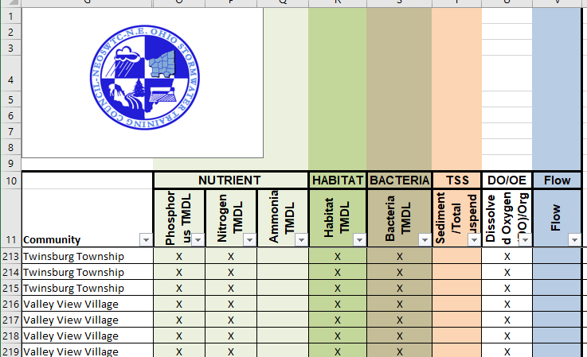
The Northeast Ohio Stormwater Training Council has developed papers on TMDLs and potential practices that may provoke ideas for input.
http://neohiostormwater.com/index.html

Slide 20
Potential Updates or Changes
Review permit language and performance measures to ensure permit requirements are clear and specific, meets federal requirements and avoids any public notice of each MS4 NOI application.

Slide 21
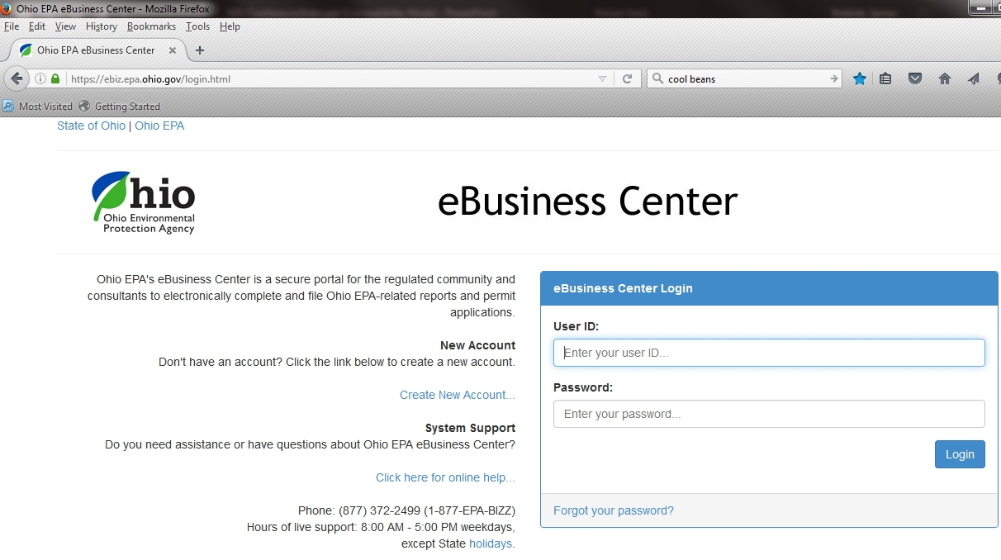
Potential Updates or Changes
Require electronic submittal of notice of intent
https://ebiz.epa.ohio.gov

Slide 22
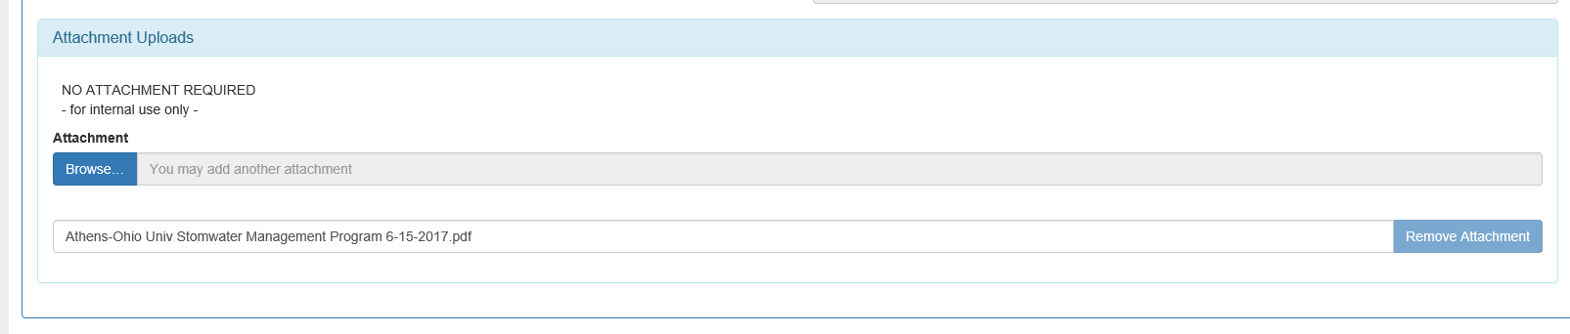
Potential Updates or Changes
Require most current Storm Water Management Program document (SWMP) to be uploaded with NOI submittal
Many have not been submitted since the first MS4 Permit (2003).

Slide 23
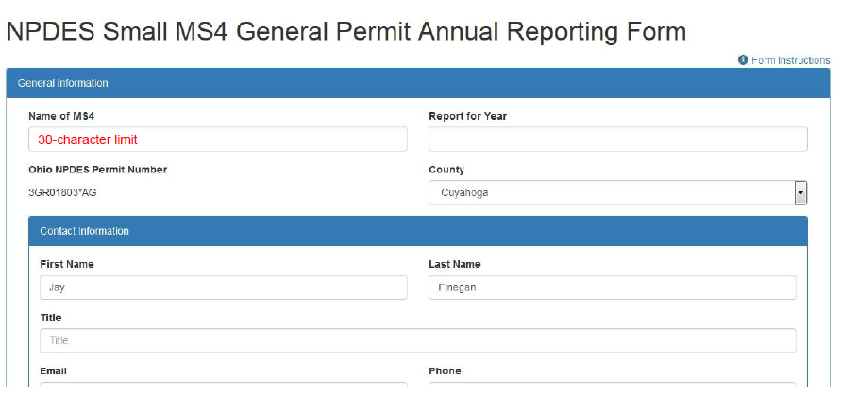
Potential Updates or Changes
Submit annual reports electronically

Slide 24
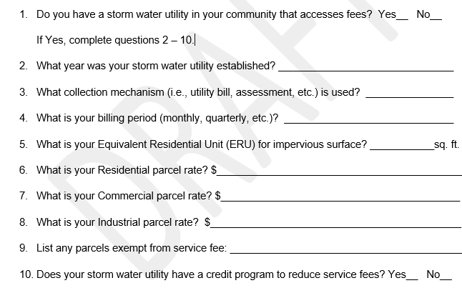
Potential Updates or Changes
Include a Storm Water Utilities survey in annual report requirements

Slide 25
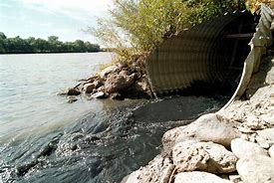
Potential Updates or Changes
Identify priority illicit discharges that require immediate notification to Ohio EPA
E.g. Cross-connections, sewage releases…

Slide 26
Please provide input:
Your input is invited! Remember, be descriptive with suggested changes and/or give examples of issues being addressed.
Send email by March 6, 2019:
Jason Fyffe
Ohio EPA, Division of Surface Water
Jason.Fyffe@epa.ohio.gov

